Slide 1
P2.3 SQL Skills
Northwind DB
Mahmoud Alhelou

Slide 2
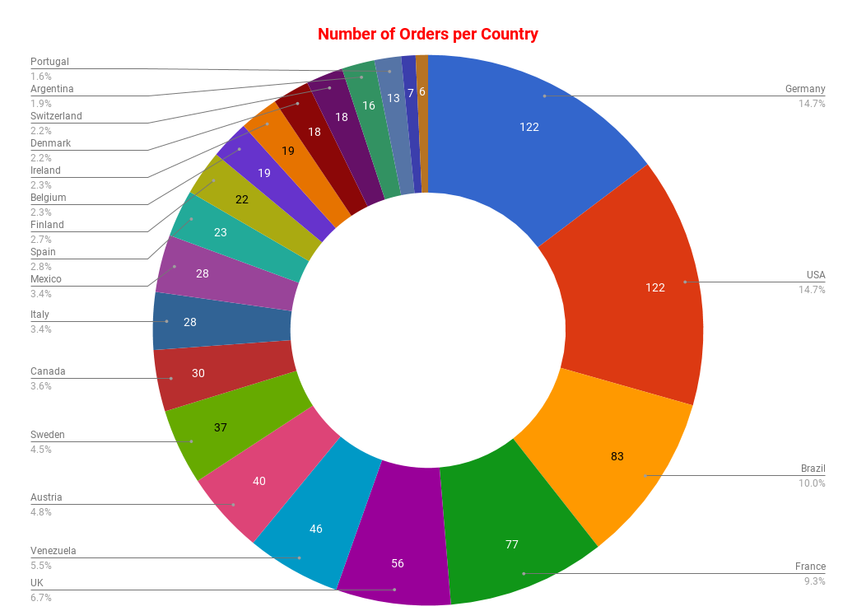
How many orders per customer?
<visualization>
From the charts, we found in our database that 14.7% of the orders come from customers from Germany ( 122 orders) and (122 orders ) from customers from USA. Then, we have 10% of the orders come from customers come from Brazil then, 9.3% from France. Then, the orders of customers start decresing till reach the lost one 6 orders from customers come Norway.

Slide 3
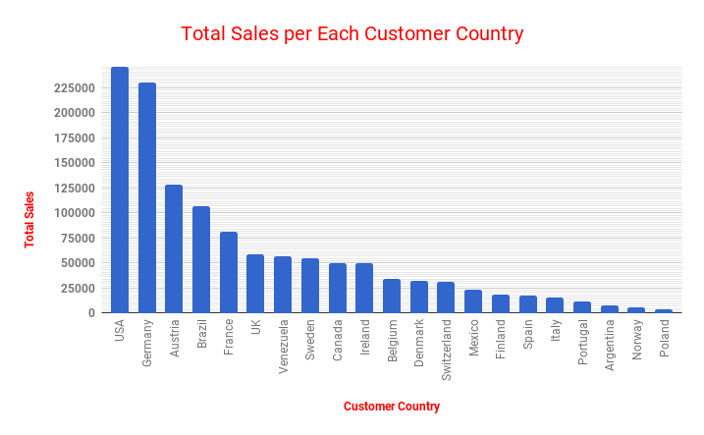
What is the total sales per each customer countries?
<visualization>
From chart, we found that the highest total sales comes from customers from USA with total sales = 245584.6 and then the second comes from Germany with total sales = 230284.6. Regarding to these numbers, we may thought that there is a relation between number of customers and the total sales but this is not fully true because the third total sales comes from Austria where the number of customers = 2 as shown before.

Slide 4
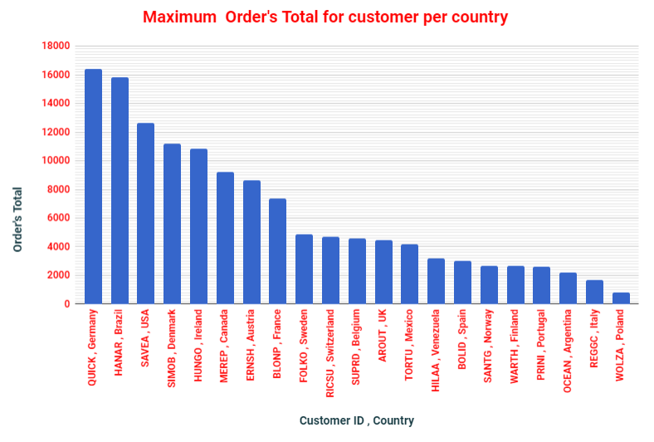
Who does have the maximum Order’s total sale and how much the total sale per each country?
<visualization>
For this query, we get the order’s total for each customer then, we found the maximum order’s total for each customer per each country.
From the chart, the highest order’s total is for Customer ID QUICK from Germany with order’s total = 16387.5 then we have HANAR from Brazil with order’s total = 15810 .
Note: In our calculation for this, we know why Austria is one of top Total sales in previous chart and found that most of Order’s total are high amount.

Slide 5
What are the top 10 products sold by customers and what is the company name of supplier?
Top 10 products sold by customers
Product Name | Company Name | Total Quantity
Camembert Pierrot | Gai p�turage | 1577
Raclette Courdavault | Gai p�turage | 1496
Gorgonzola Telino | Formaggi Fortini s.r.l. | 1397
Gnocchi di nonna Alice | Pasta Buttini s.r.l. | 1263
Pavlova | Pavlova, Ltd. | 1158
Rh�nbr�u Klosterbier | Plutzer Lebensmittelgro�m�rkte AG | 1155
Guaran� Fant�stica | Refrescos Americanas LTDA | 1125
Boston Crab Meat | New England Seafood Cannery | 1103
Tarte au sucre | For�ts d'�rables | 1083
<visualization>
In the table, we show the top 10 products sold by customers and show the company name of supplier. Also, we show the total quantities for these 10 products. We have special characters so we leave it as it is.
The highest and second products sold come from France then the third and forth come from Italy.

